Slide 1


ATLIQ HARDWARES
CONSUME R GOODS
AD-HOC INSIGHTS
Presented by Rishi kumar

Slide 2
Contents
Introduction
Business Scenario
Database Overview
Ad-Hoc Requests
Conclusion
Recommendations

Slide 3
Introduction
Atliq Hardware stands as a leading computer hardware manufacturer based in India, distinguishing itself with a substantial global footprint encompassing operations in 27 countries. With an extensive clientele of 74, Atliq Hardware has firmly entrenched its presence in key regions, including Asia Pacific (APAC), Europe (EU), North America (NA), and Latin America (LATAM).
The company excels in three primary product divisions, each contributing to its diverse and expansive portfolio: Peripherals and Accessories (P & A), Network and Storage (N & S), and Personal Computer (PC). This comprehensive array of offerings positions Atliq Hardware as a versatile and dependable choice for consumers worldwide.

Slide 4
Key Considerations
The dataset covers fiscal years 2020 and 2021, detailing Atliq Hardware's financial performance.
The fiscal year runs from September 1st to August 31st, aligning with Atliq Hardware's reporting cycle.
The database comprises six key tables: dim_customer (Customers), dim_product (Products), fact_gross_price (Gross Prices), fact_manufacturing_cost (Manufacturing Costs), fact_pre_invoice_deductions (Pre-Invoice Deductions), and fact_sales_monthly (Monthly Sales).
These tables capture customer info, product details, gross prices, manufacturing costs, pre-invoice deductions, and monthly sales.
The dataset enables analysis of customer interactions, product performance, pricing trends, manufacturing
efficiency, and financial adjustments.
It serves as a valuable resource for informed decision-making, offering insights into business operations and areas for improvement or growth.

Slide 5
Ad-hoc Requests

Slide 6
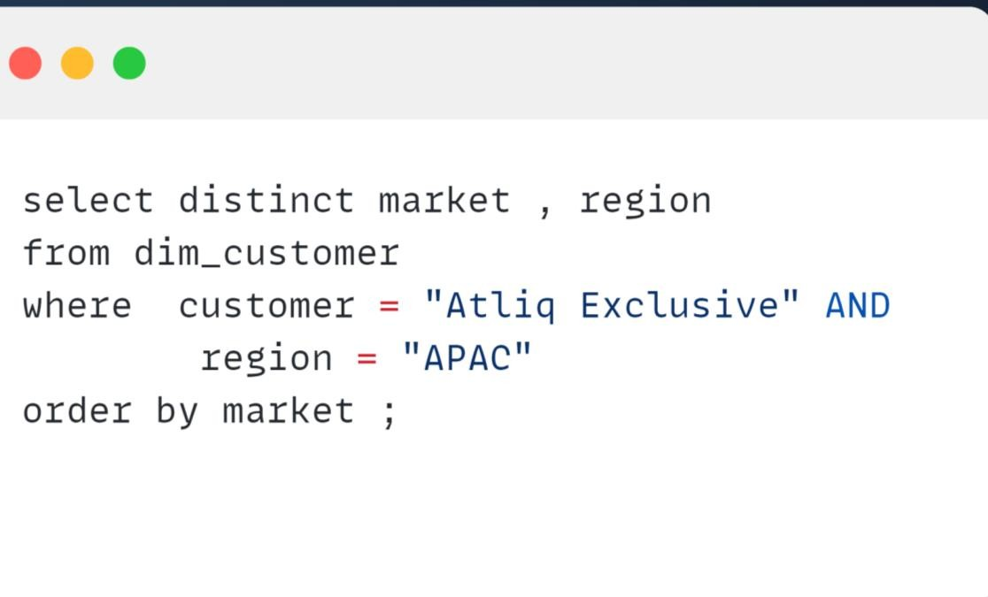
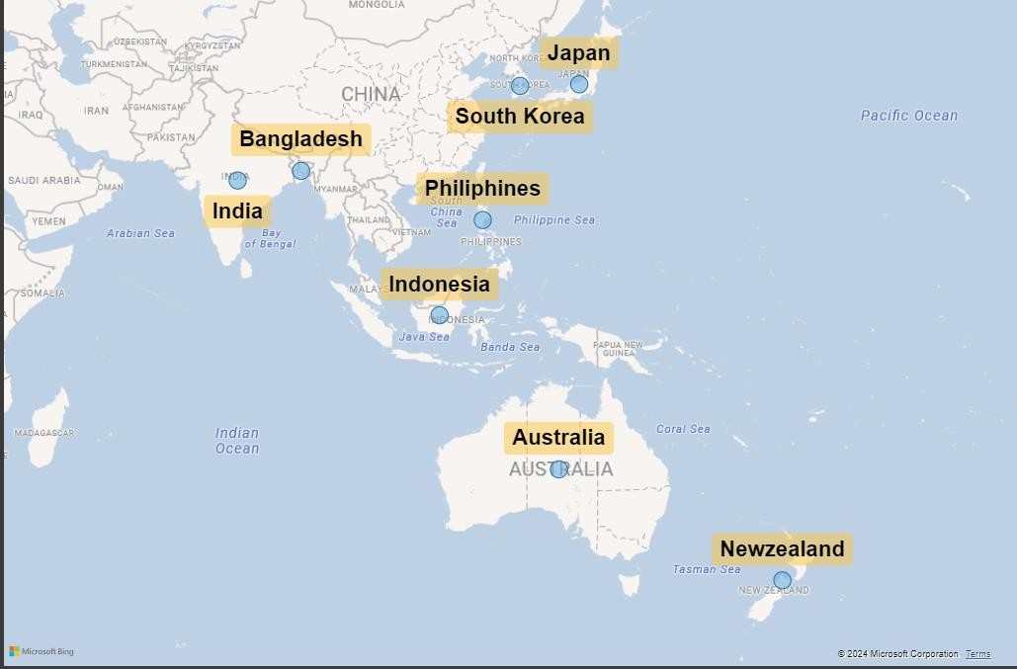
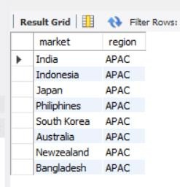
AD_HOC-REQUEST:1
Provide the list of markets in which customer "Atliq Exclusive" operates its
business in the APAC region.
Insights
Atliq Exclusive operates its business across
eight diverse countries in the Asia-Pacific (APAC) region

Slide 7
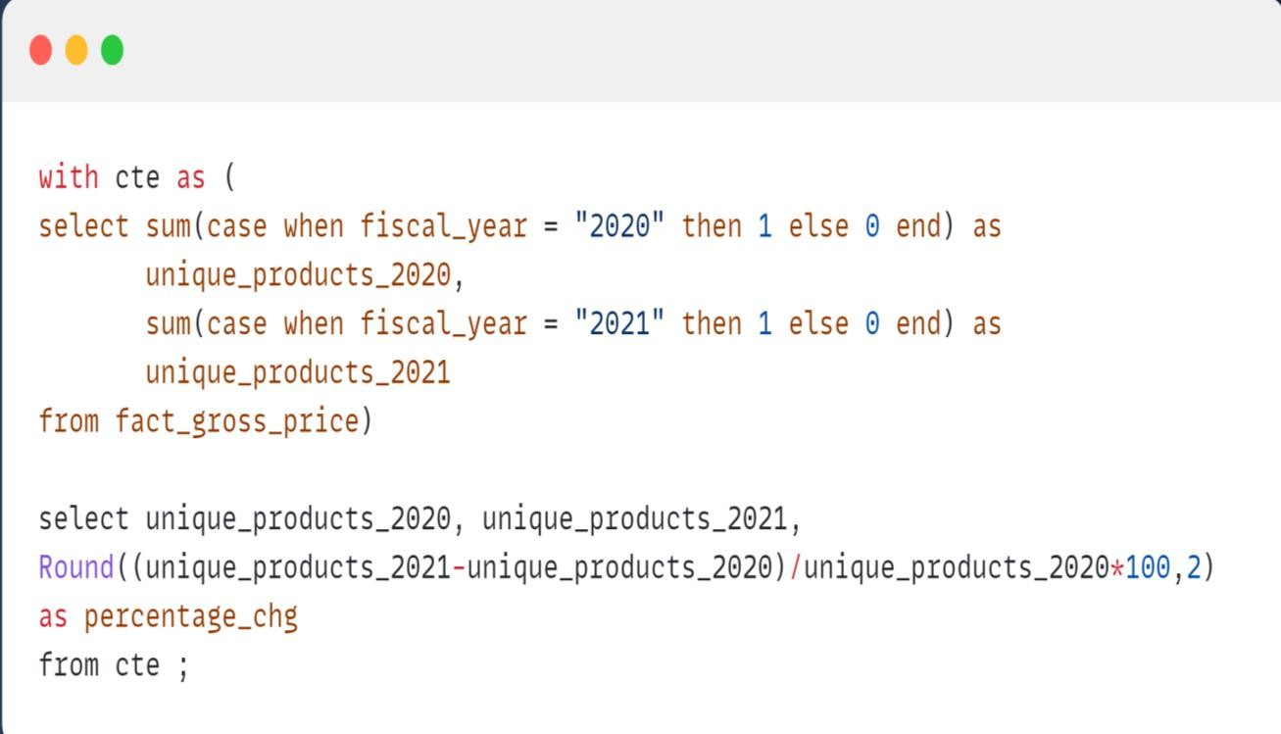
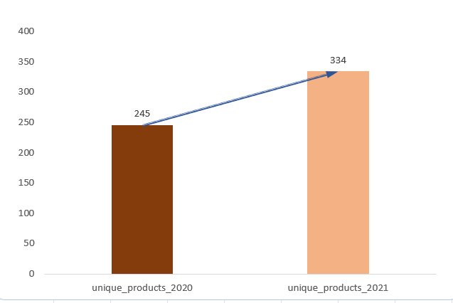

AD_HOC-REQUEST:2
What is the percentage of unique product increase in 2021 vs.
2020?
Insights
The remarkable growth of 36.33% in the unique product count from 2020 to 2021 indicates a substantial expansion of the business over the past year.

Slide 8
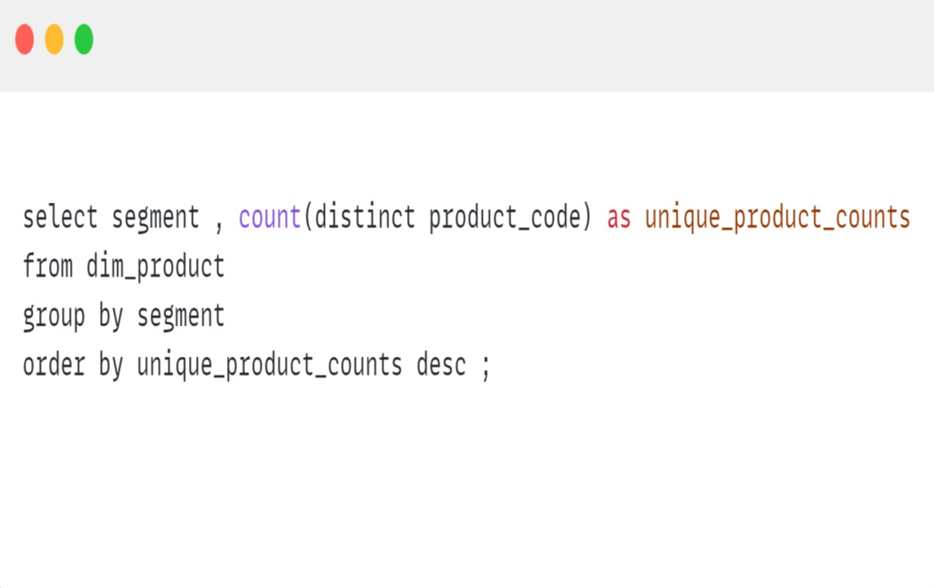
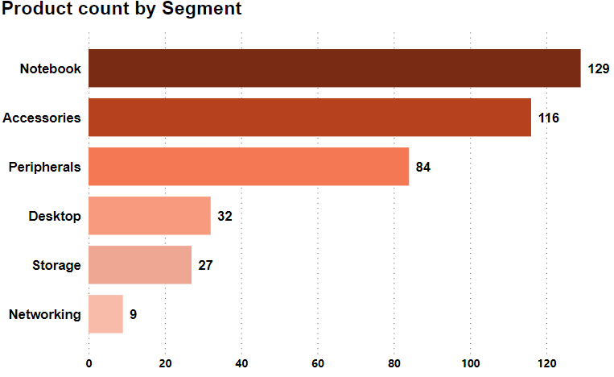
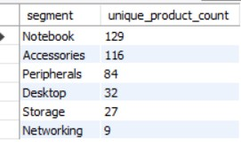
AD_HOC-REQUEST:3
Provide a report with all the unique product counts for each segment and sort them in descending order of product counts.
Insights
The Networking segment of the company has the lowest product count, whereas the Notebook segment has the highest. This implies that the company may have recently bolstered its sales and marketing efforts in the Networking segment, possibly in response to a surge in demand.

Slide 9
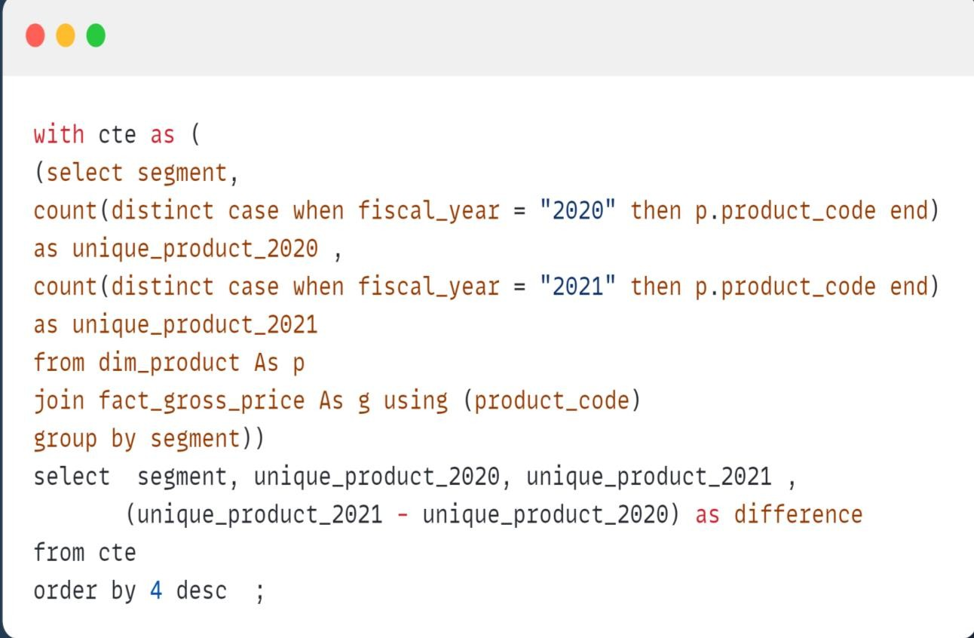
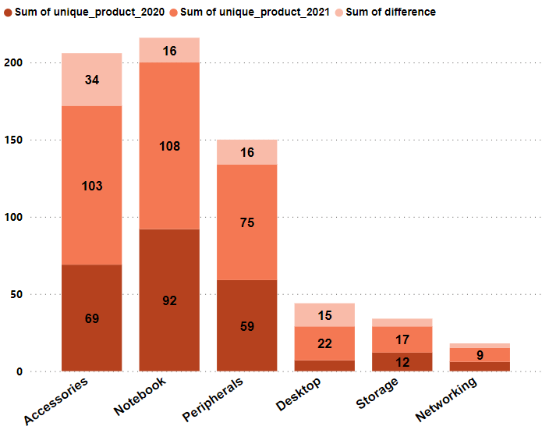
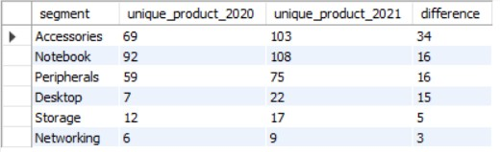
AD_HOC-REQUEST:4
Follow-up: Which segment had the most increase in unique products
in2021 vs 2020?
Insights
The Accessories segment witnessed the most substantial surge in unique products between 2020 and 2021, while the Desktop segment demonstrated the highest percentage increase.

Slide 10
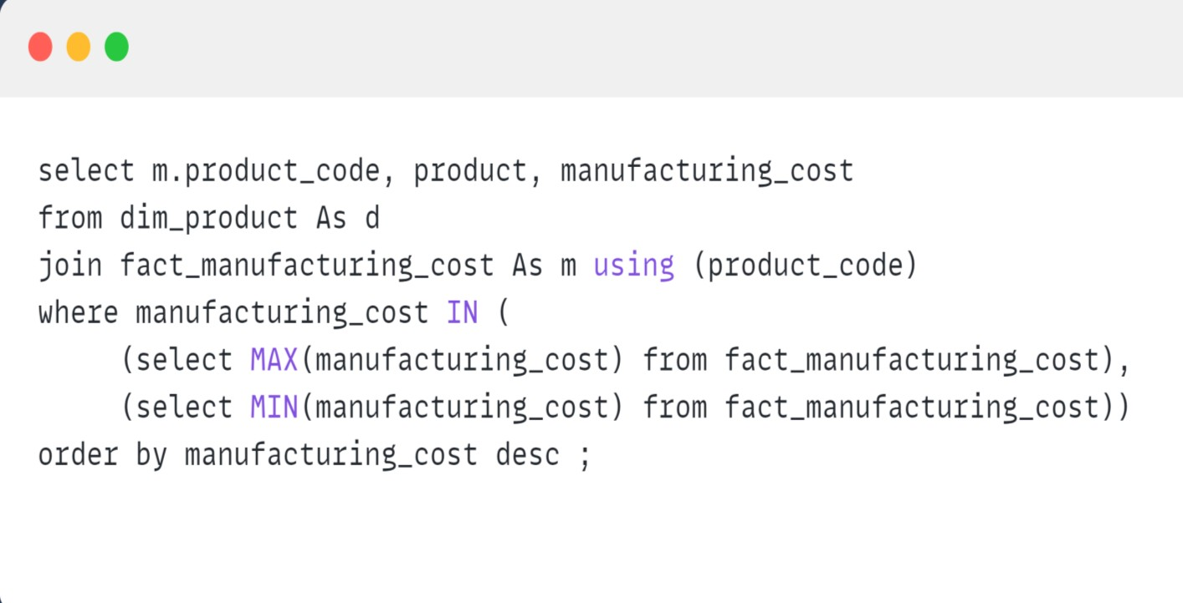
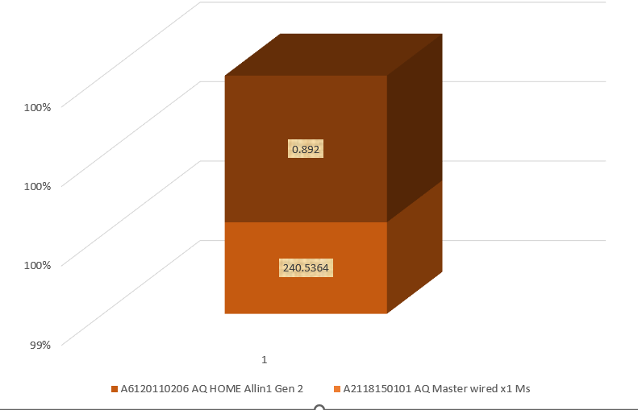

Get the products that have the highest and lowest manufacturing costs.
AD_HOC-REQUEST:5
Insights
The AQ Home Allin1 Gen 2 incurs the highest manufacturing cost, while the lowest manufacturing cost is associated with AQ Master Wired x1 Ms.

Slide 11
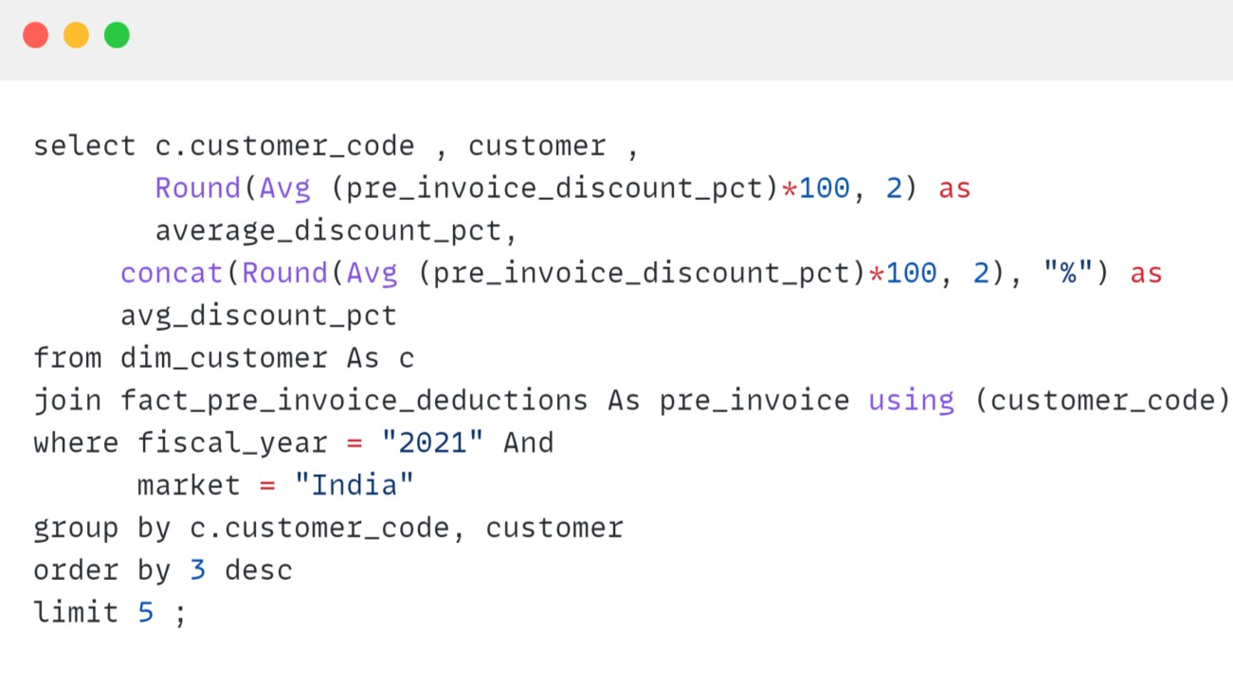
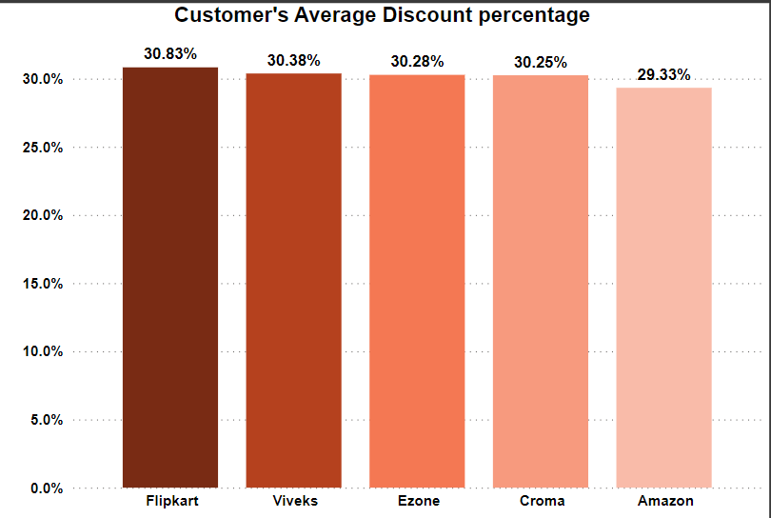
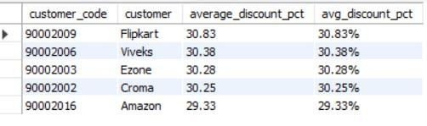
Generate a report which contains the top 5 customers who received an average high pre_invoice_discount_pct for the fiscal year 2021 and in the Indian market.
AD_HOC-REQUEST:6
Insights
The collective average pre-invoice discount percentage for the top 5 customers stands at 30.21%, exhibiting minimal variation among them.

Slide 12
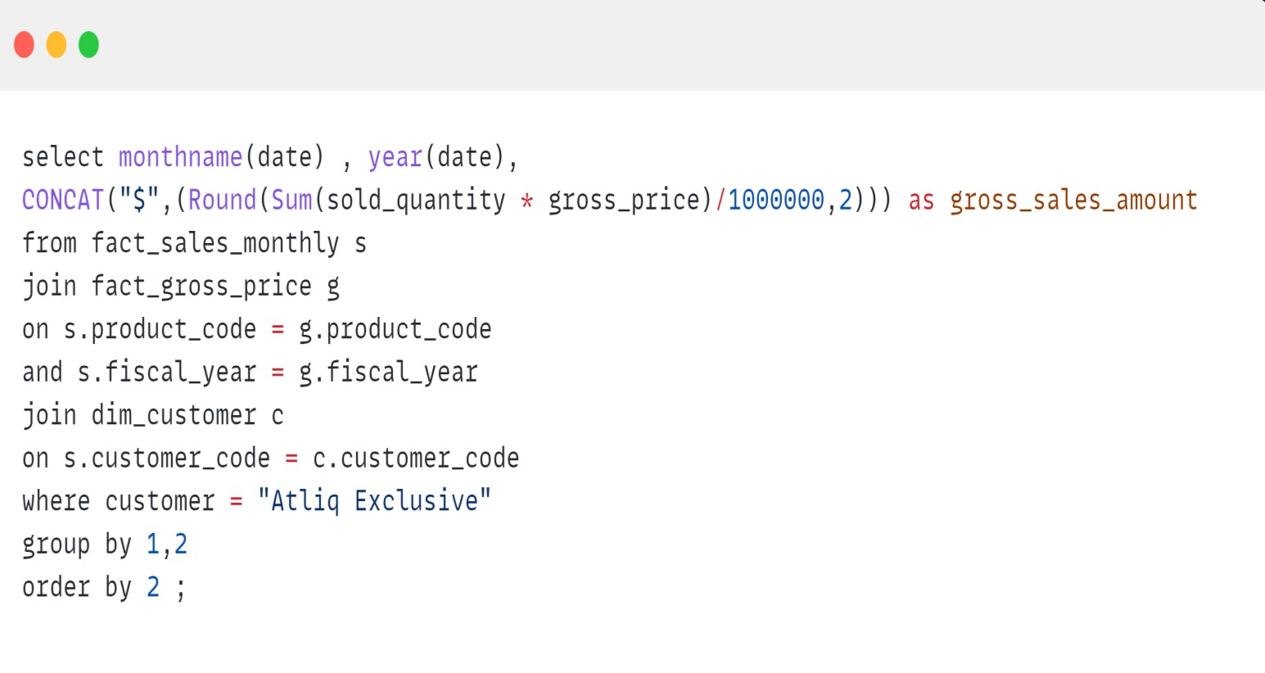
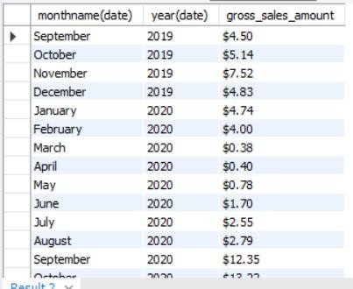
AD_HOC-REQUEST:7
Get the complete report of the Gross sales amount for the customer “Atliq
Exclusive” for each month.
Insights
In November 2020, the company attained its highest monthly sales, reaching $20.46 million, whereas March 2020 marked the lowest monthly gross sales at $0.38 million. The fiscal year 2020 concluded with a total sales figure of $39.33 million. In contrast, fiscal year 2021 witnessed a substantial increase, reaching a total sales amount of $142.19 million.

Slide 13
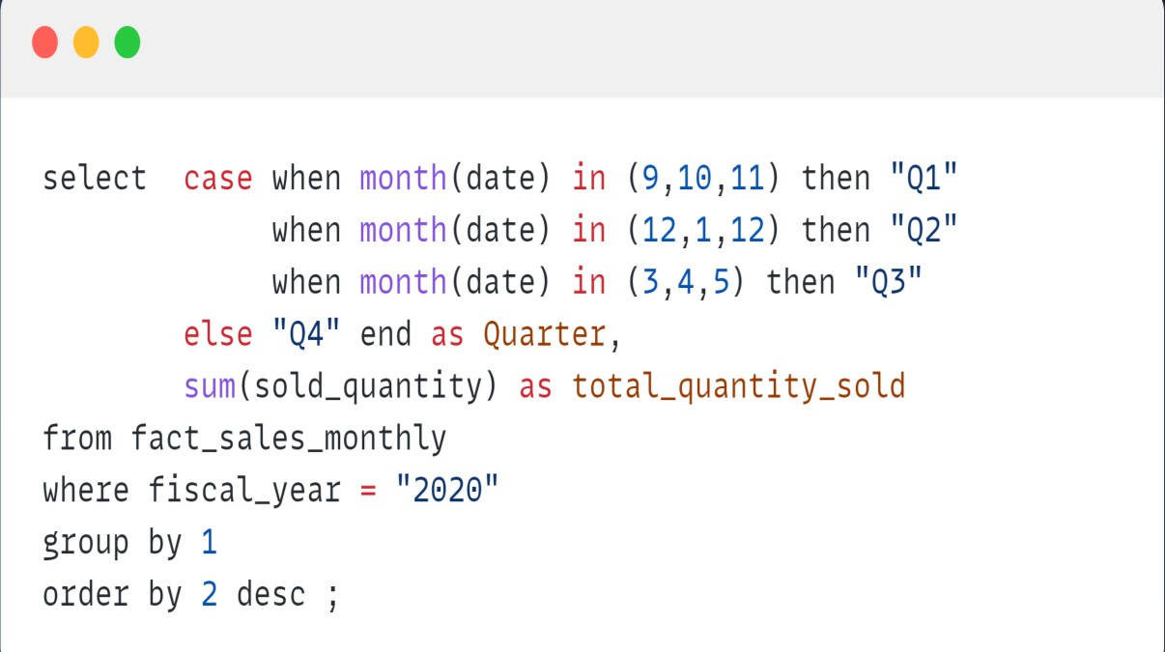
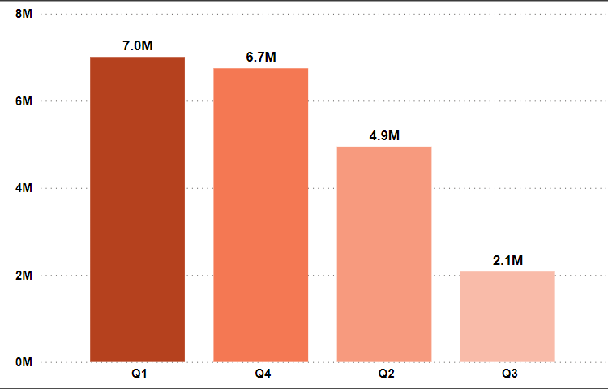
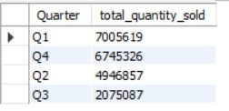
AD_HOC-REQUEST:8
In which quarter of 2020, got the maximum total_sold_quantity?
Insights
The sales figures for the respective quarters are ranked highest to lowest as follows: Q1, Q2, Q4, and Q3.

Slide 14
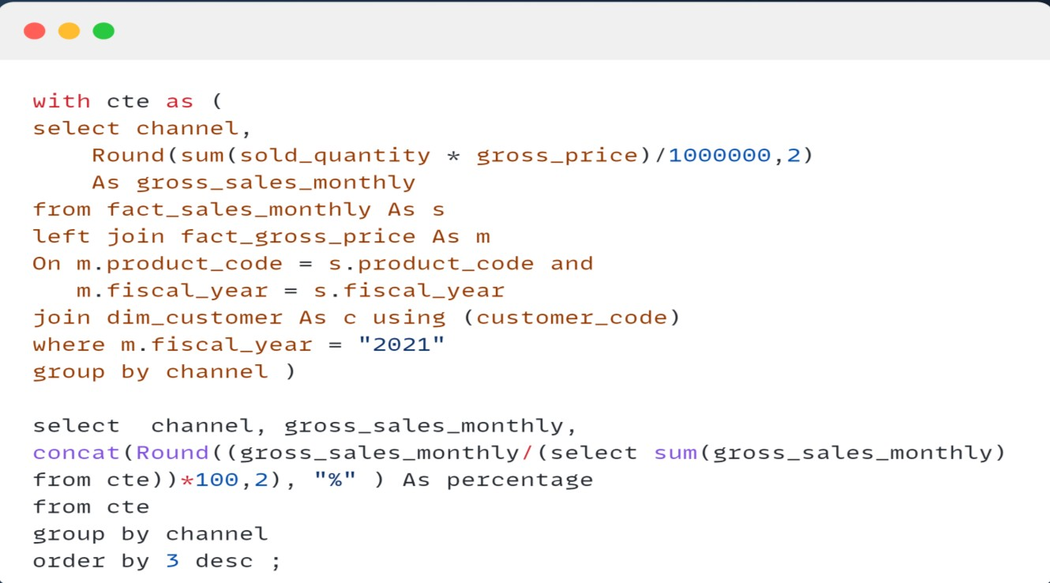
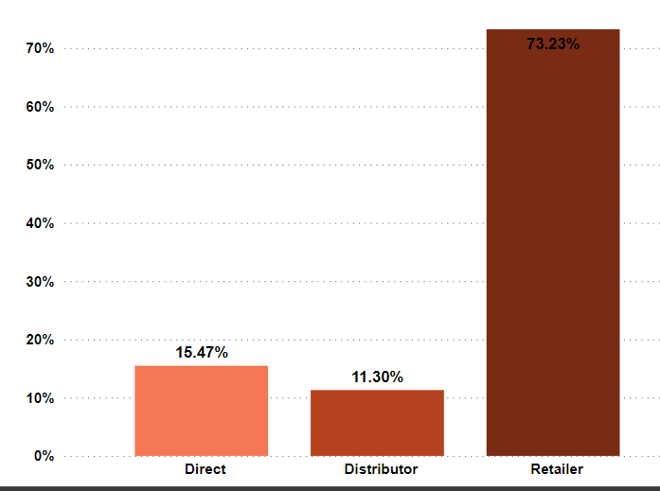
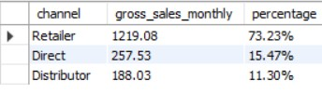
AD_HOC-REQUEST:9
Which channel helped to bring more gross sales in the fiscal year 2021and the
percentage of contribution?
Insights
Throughout 2021, the primary driving force behind the company's sales revenue was retailers, constituting the highest percentage of gross sales at 73.22%. Direct sales comprised 15.47% of the total, and distributors played a comparatively smaller role, contributing 11.31%. This underscores the significant contribution of retailers to the overall sales performance, with direct and distributor sales playing secondary roles in the company's revenue structure.

Slide 15
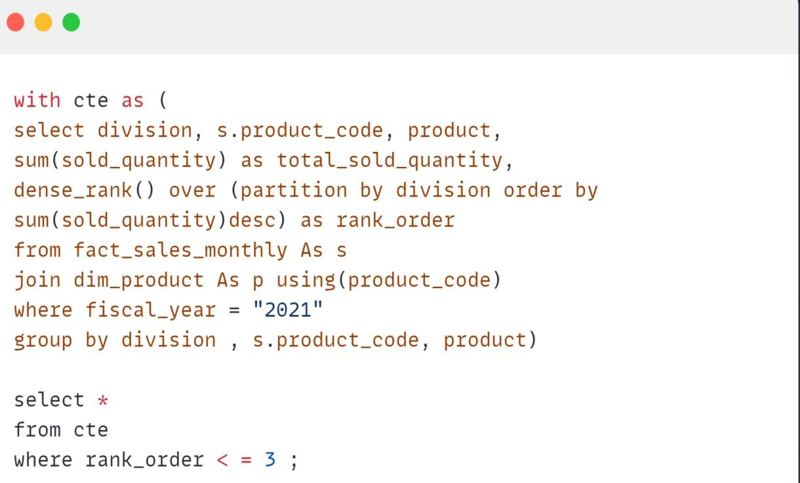
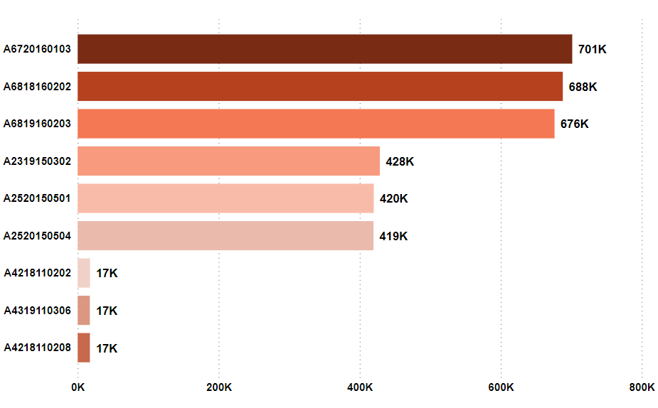
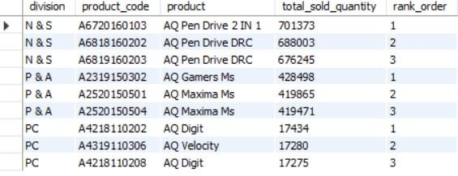
AD_HOC-REQUEST:10
Get the Top 3 products in each division that have a high total_sold_quantity in the fiscal_year 2021?
Insights
The standout performers among the best-selling
products in the fiscal year 2021 were:
Leading the pack in Network and Storage (N & S), the AQ Pen Drive.
Securing top positions in Peripherals & Accessories (P & A), the AQ Gamer Ms.
In the realm of Personal Computer (PC), the AQ Digit emerged as a top choice.

Slide 16
Conclusions

Slide 17
AtliQ Exclusive operates in eight different countries across Asia, contributing to marketing and sales efforts.
The variety of products witnessed a substantial increase of 36.33% from 2020 to 2021, indicating significant business growth and an expanded product range.
Analyzing product categories helps identify strengths and weaknesses, guiding strategic focus. Notably, Accessories experienced the most substantial increase in product diversity, emphasizing the importance of expanding this category.
Understanding the production costs of various products aids in decision-making regarding production processes and pricing strategies.
Identifying the top 5 customers receiving significant pre-invoice discounts offers insights into customer engagement strategies.
Regularly monitoring monthly sales data assists in determining optimal periods for key business decisions. Sales data reveals a peak in product sales during the first quarter of 2020, suggesting potential trends for planning and inventory management.
Notably, retailers played a pivotal role in the company's income in 2021, underscoring their significance.
Recognizing the top-performing products in each category in 2021 provides valuable guidance for marketing and strategic focus.

Slide 18
Recommendations
Enhance Market Penetration: Utilize insights derived from the analysis to strategically expand operations in the Asia-Pacific (APAC) region, with a focus on high-potential markets.
Product Diversification: Capitalize on the observed growth in unique products by continuing to diversify the product
portfolio, especially in high-performing segments such as Accessories.
Strategic Marketing: Tailor marketing strategies for each segment using segment-wise product counts and insights on unique product increases (Q4).
Cost Optimization: Review products with the highest manufacturing costs to identify opportunities for cost optimization, ensuring competitiveness in the market.
Customer Relationship Management: Maintain robust relationships with top customers identified in the analysis, considering the implementation of loyalty programs or exclusive offerings.
Sales Forecasting: Utilize monthly gross sales data to identify seasonal trends for more accurate sales forecasting, thereby aiding in efficient inventory management.
Strategic Sales Focus: Prioritize sales efforts strategically, based on channel contribution, focusing on retailers and direct
channels for maximum impact.
Product Performance Analysis: Regularly analyze the performance of top products in each division to adapt to changing market demands and consumer preferences. This ongoing analysis will facilitate informed decision-making and strategic adjustments.

Slide 19
THANK YOU

